Slide 1

Applications of GIS
Week 8
Assignment 4: Disaster management in GIS Introduction

Slide 2
Today’s Tutorial
Assignment 4 overview
Q&A and working on Assignment 3

Slide 3
Assignment 4
The State government for an Australian state has contracted you to perform a risk analysis for a natural disaster of either floods or bushfires.
You are required to produce a response plan for emergency response teams and the general public for future disaster events.
Information, statements and recommendations related to the following will be provided:
Population movement management
Environment impact
Industry response plans
Infrastructure management and protection

Slide 4
Assignment 4
You are required to provide various risk maps including:
Hazard Map(s)
Elements at risk map(s) / Vulnerability map(s)
A final risk map combining according to the risk formula

Slide 5
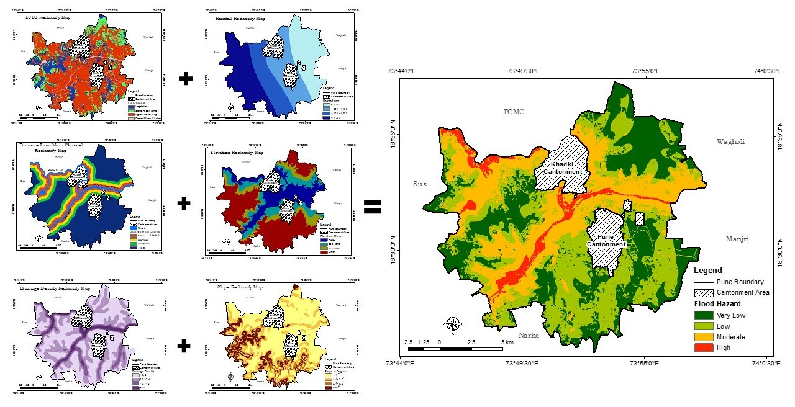
Multi-criteria analysis
The last assignment was a multi-criteria analysis, although we are going more in depth and getting more complex with this with assignment.
Multi-criteria analysis is used for many purposes, such as where to places infrastructure? Where to build a new McDonalds? Or in this cases which places are at most risk of a natural disaster?
We are getting lots of datasets, seeing how they can represent risk of a natural disaster, creating a relative hazard and relative risk score, which will then show us where the most at risk places are in a chosen state.
Lecture 7

Slide 6
Assignment 4 – Risk analysis
Risk analysis can be analysed spatially with the following risk formula:
Risk = Hazard * Elements at Risk * Vulnerability

Slide 7
Assignment 4 – Risk analysis examples
Tree Density
Environment
Accessibility to roads
Rainfall
Industry
Geology
Elderly & Children
Risk = Hazard * Elements at Risk * Vulnerability
Distance to emergency services
Topography
Infrastructure
Population Density
Land cover

Slide 8
Assignment 4 – Risk analysis examples
Tree Density
Environment
Accessibility to roads
Rainfall
Industry
Geology
Elderly & Children
Risk = Hazard * Elements at Risk * Vulnerability
Distance to emergency services
Topography
Infrastructure
Population Density
Land cover

Slide 9
Report Layout
Cover Page
Abstract
Introduction
Literature Review
Methodology
Results
Discussion
Conclusion
References
Appendices
Individual reflection

Slide 10
Do the assignment in 5 easy step!
Do literature review, the information learned from reading other people’s literature will form a strong foundation of how you will conduct your analysis and which areas you will focus on for your report. More important than previous assignments
Key search terms: Multi-criteria analysis, risk analysis, GIS risk analysis, spatial analysis in natural disasters, risk mapping
Look for which risk factors were used in analysis, what data did they use, how did they do it? How could you replicate this in ArcGIS pro.
Get some data, from the literature review what environmental/ community/ risk factors were used in other people’s analysis. Start downloading data from sources, data.vic.gov.au, AURIN, etc.
Make Hazard raster layers, using tools from workflow and literature review start doing analysis and making raster layers that represent a natural disaster hazard, these will then be combined to calculate total hazard then risk. Main thing you need to do is create a score from the raw data values to a relative score of 1-10 for each raster.
Make layers for elements at risk and vulnerability, what are the community/ environmental/ industrial elements at risk and how are they more vulnerable? Combine these layers with hazard layers to get risk for each element at risk.
Write report, literature review should be mostly written, write method and then focus on discussion combine how your results compared to other peoples, what are the main take away from analysis, recommendations to the government. Conclusion, make sure to include limitations and future analysis.

Slide 11
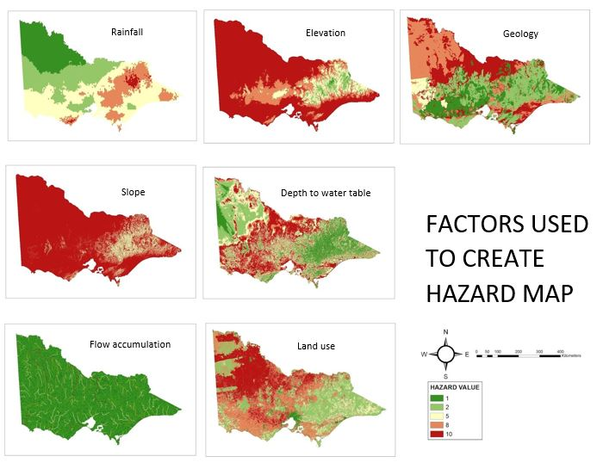
Example maps: Floods

Slide 12
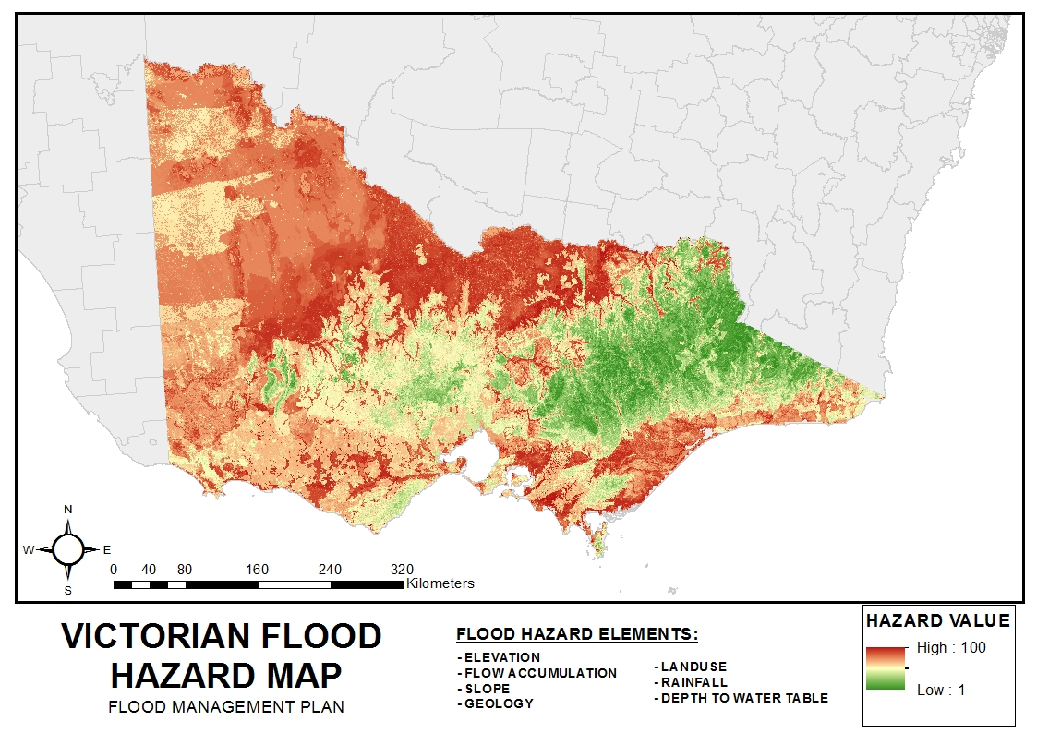
Example maps: Floods

Slide 13
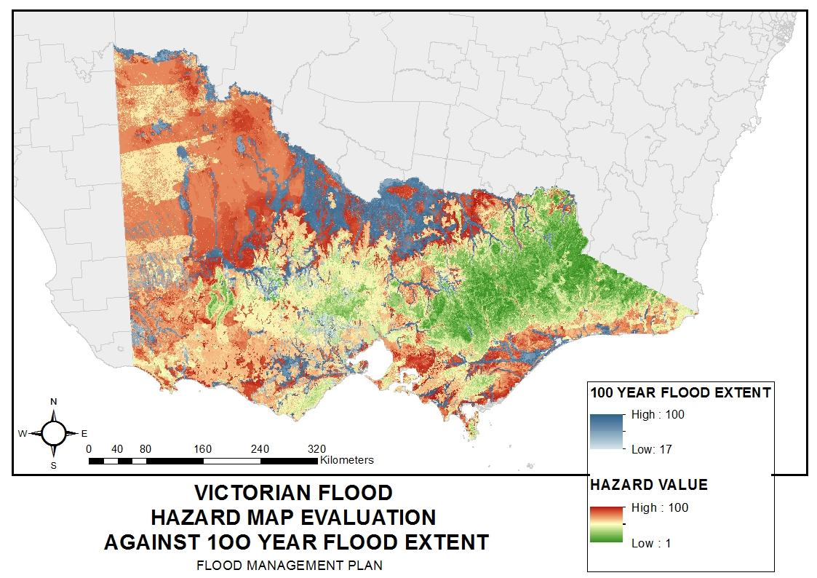
Example maps: Floods

Slide 14
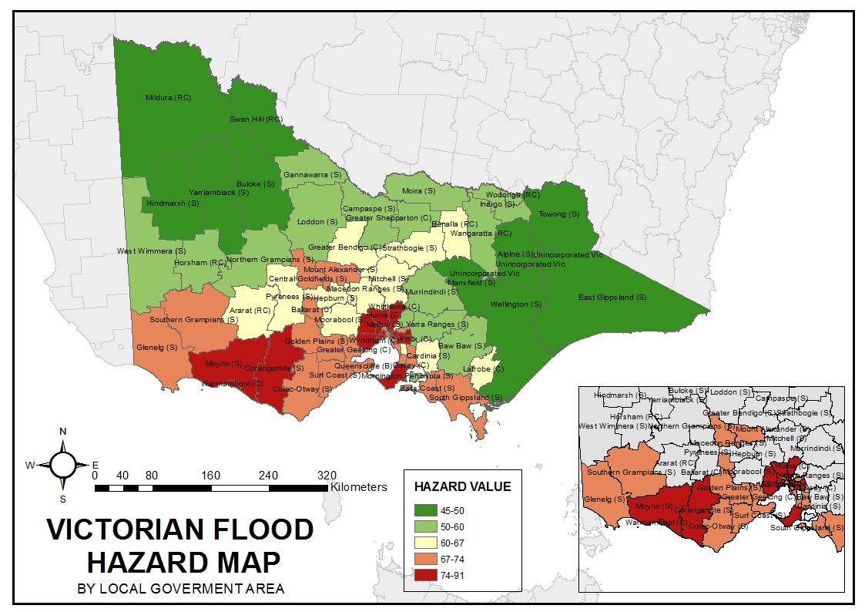
Example maps: Floods

Slide 15
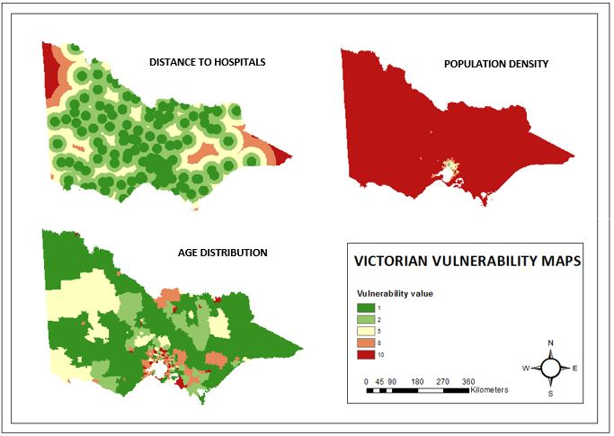
Example maps: Floods

Slide 16
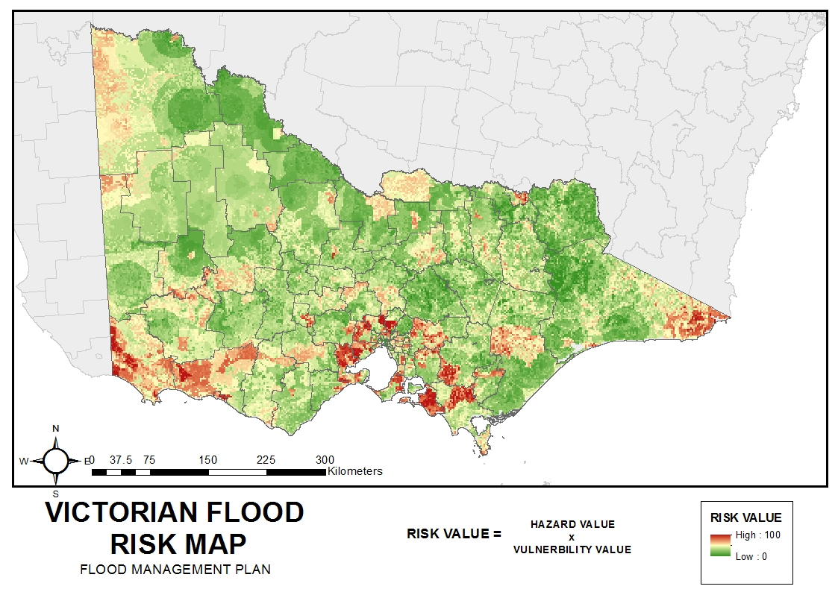
Example maps: Floods

Slide 17
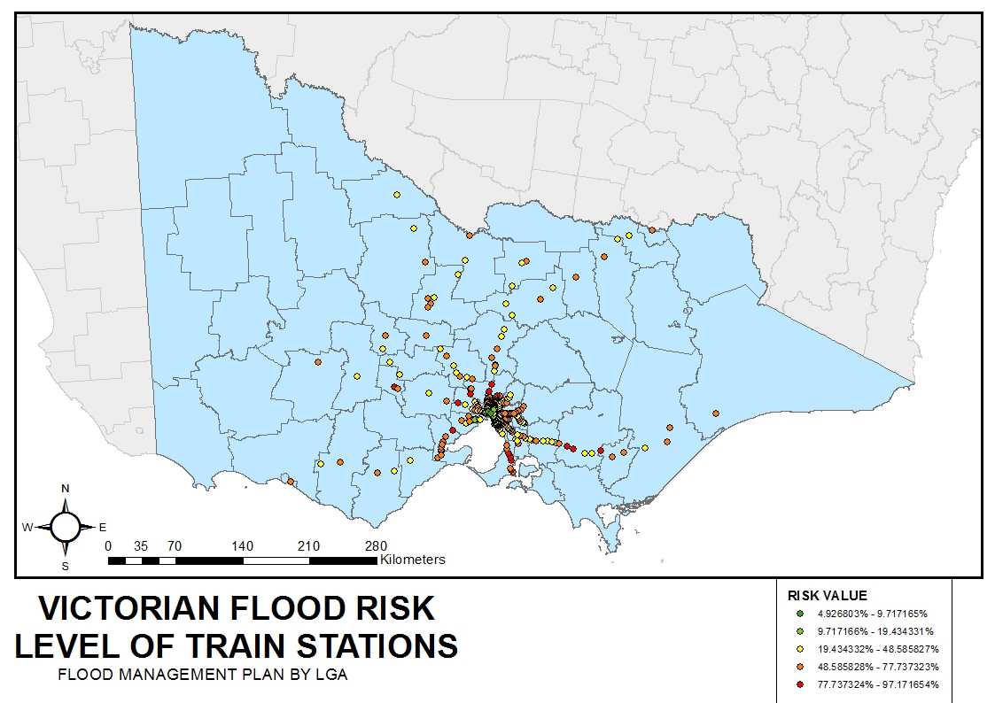
Example maps: Floods

Slide 18
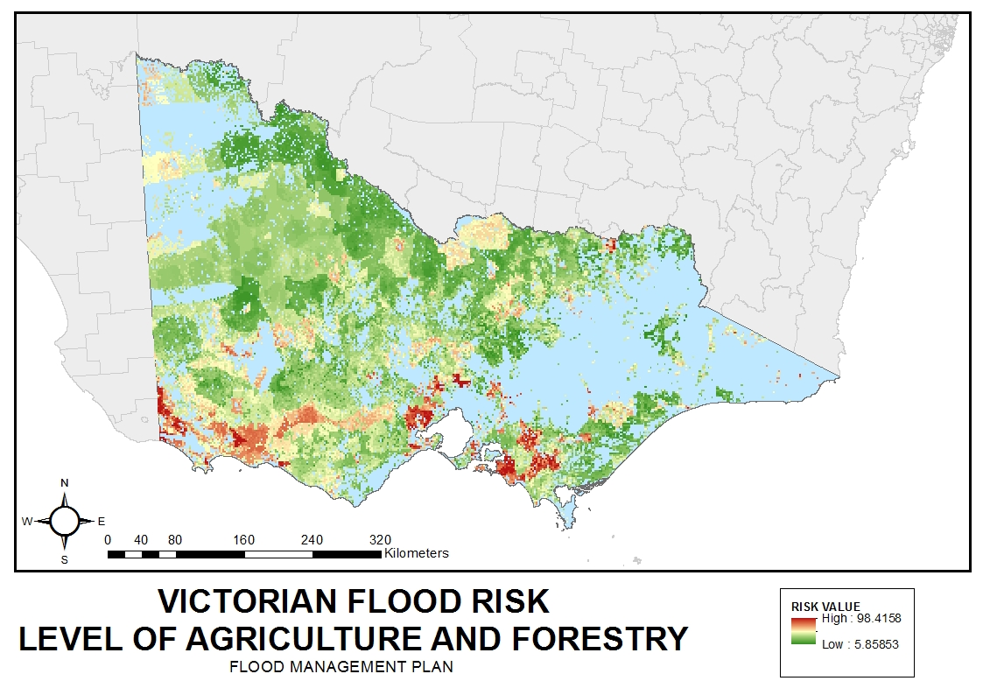
Example maps: Floods

Slide 19
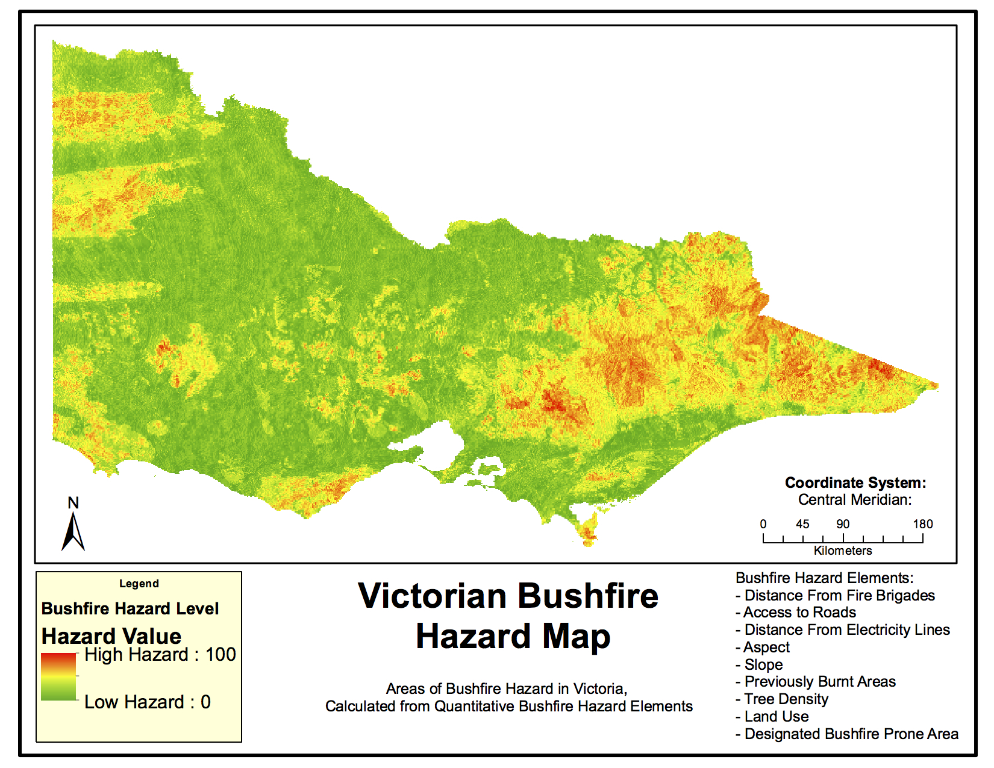
Example maps: Bushfires

Slide 20
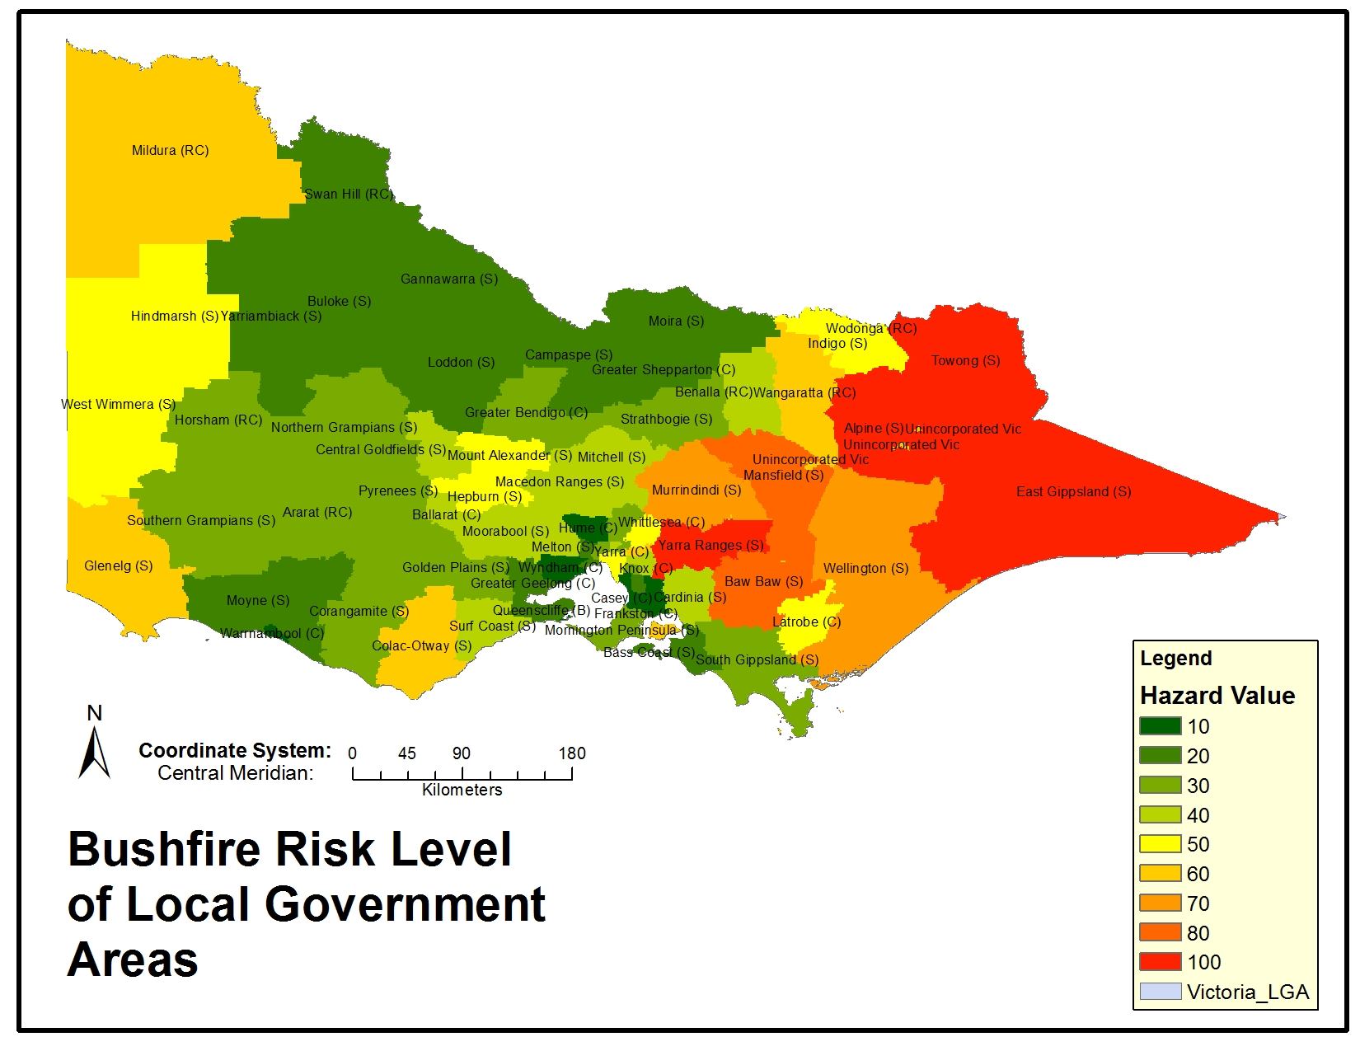
Example maps: Bushfires

Slide 21
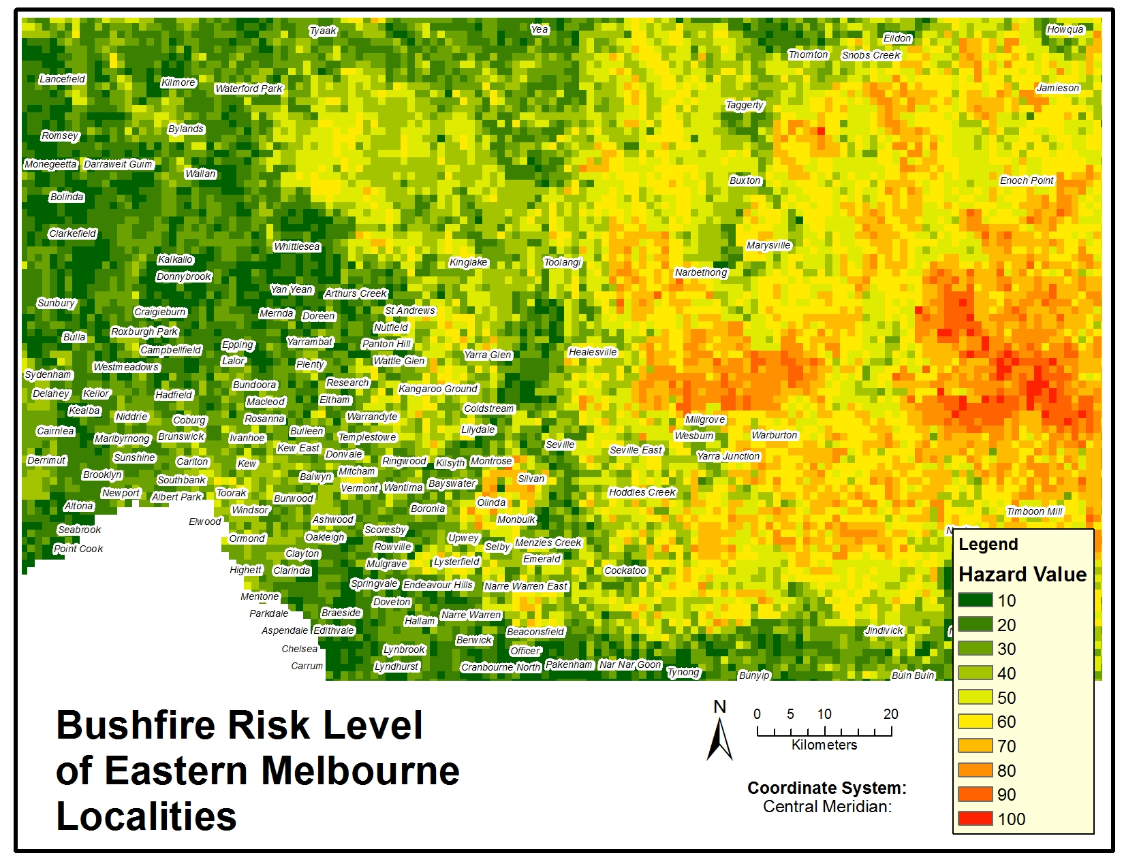
Example maps: Bushfires

Slide 22
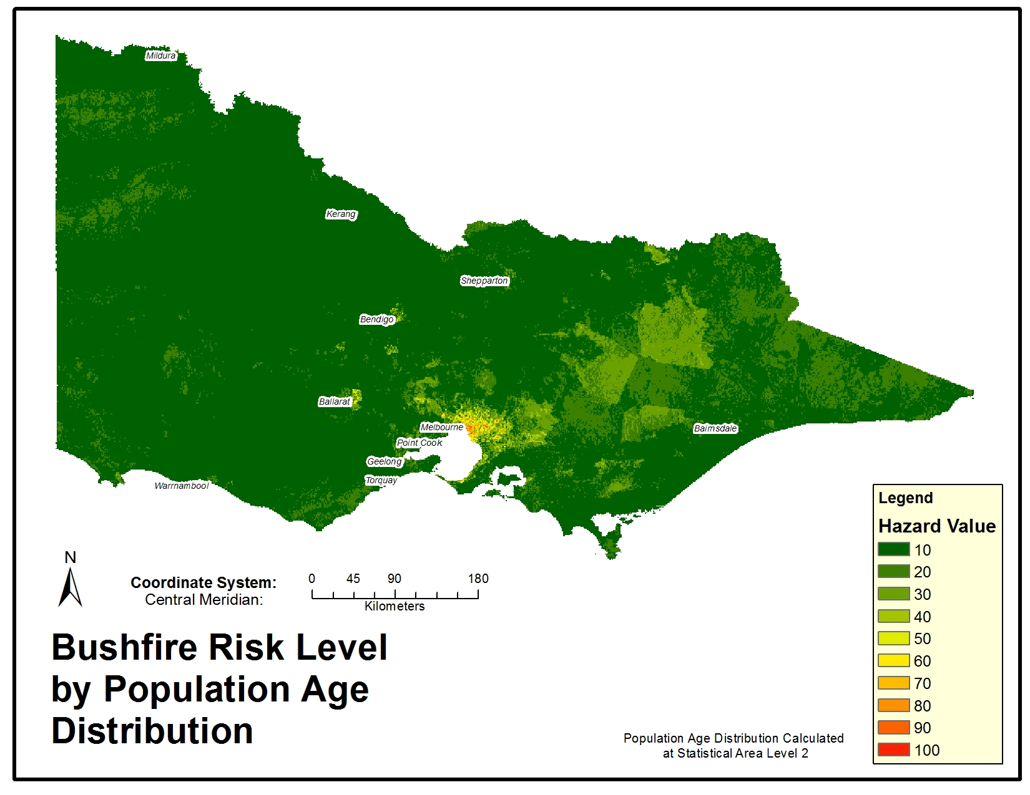
Example maps: Bushfires

Slide 23
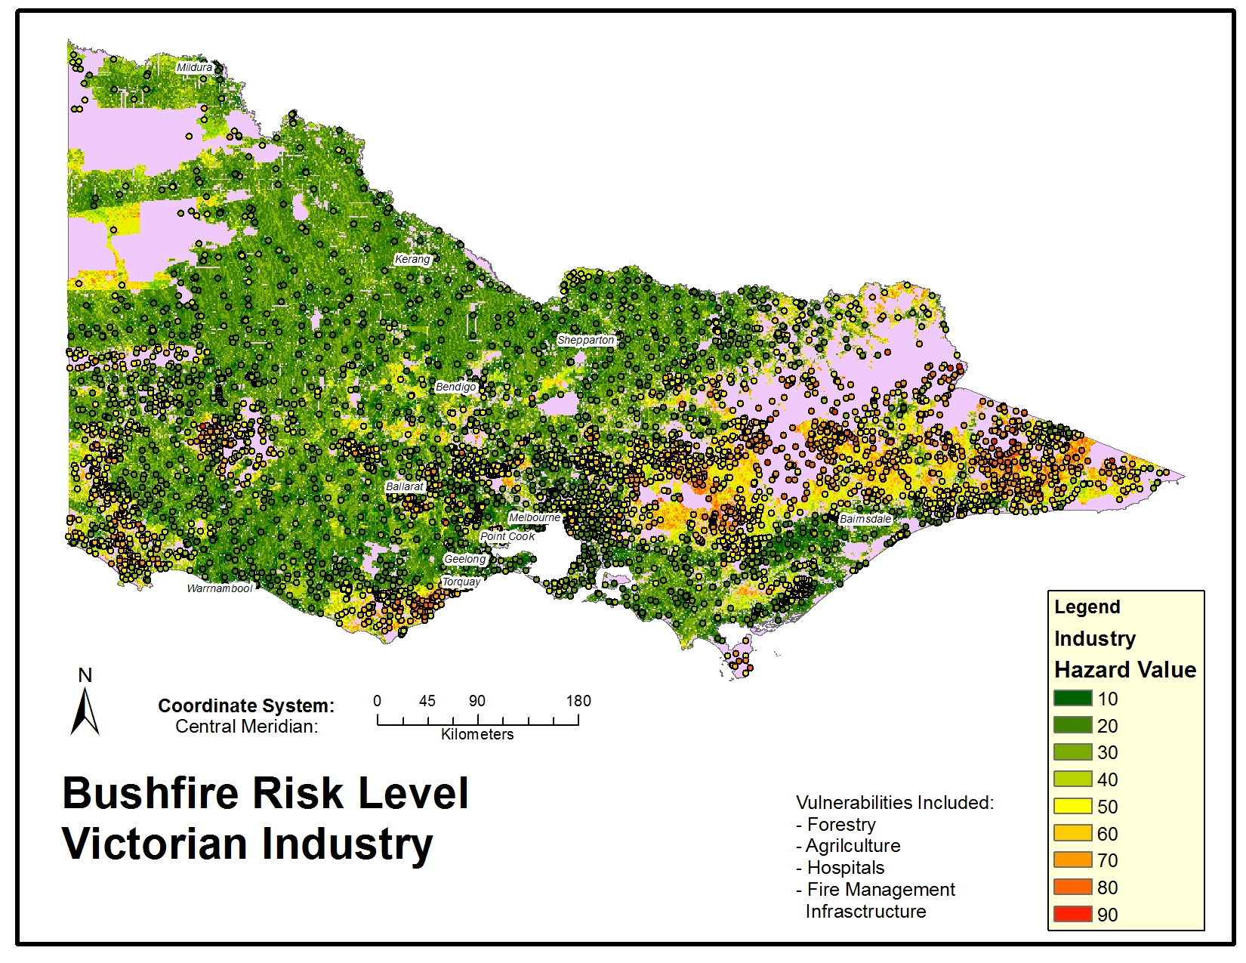
Example maps: Bushfires

Slide 24
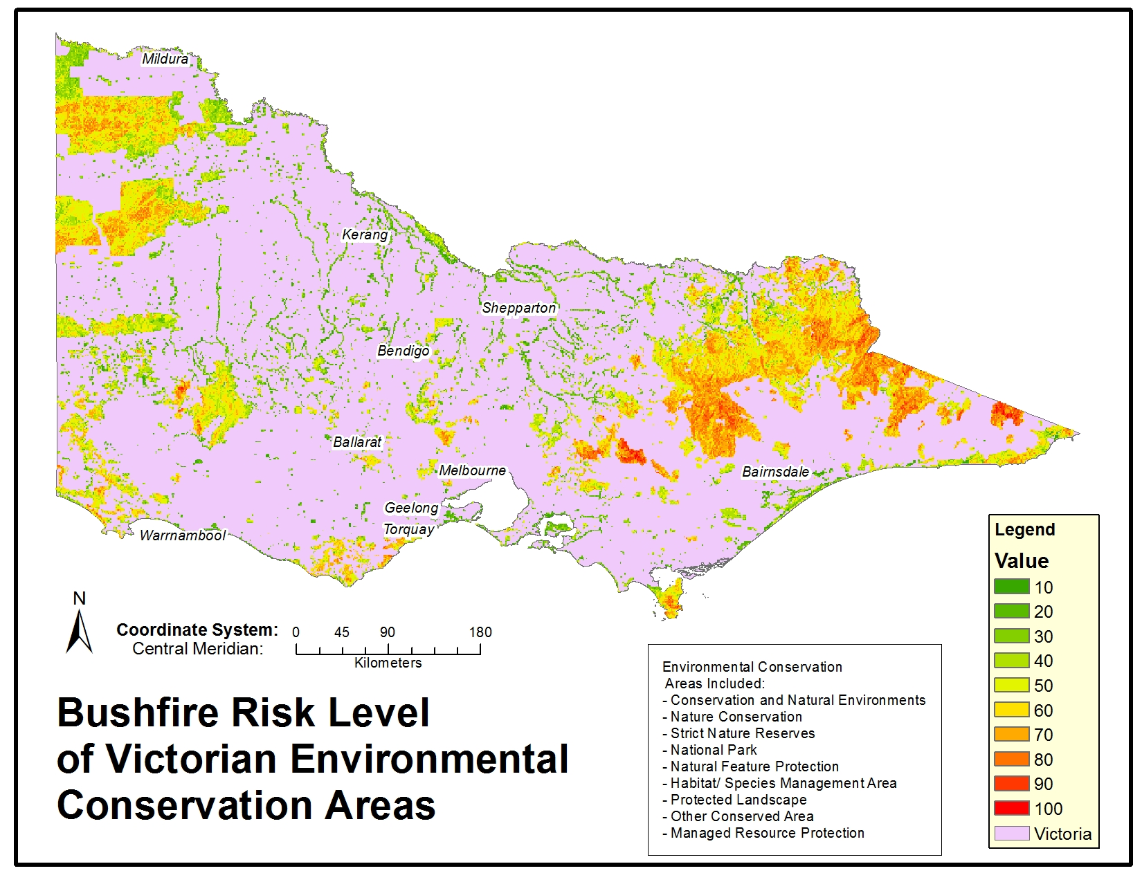
Example maps: Bushfires

Slide 25
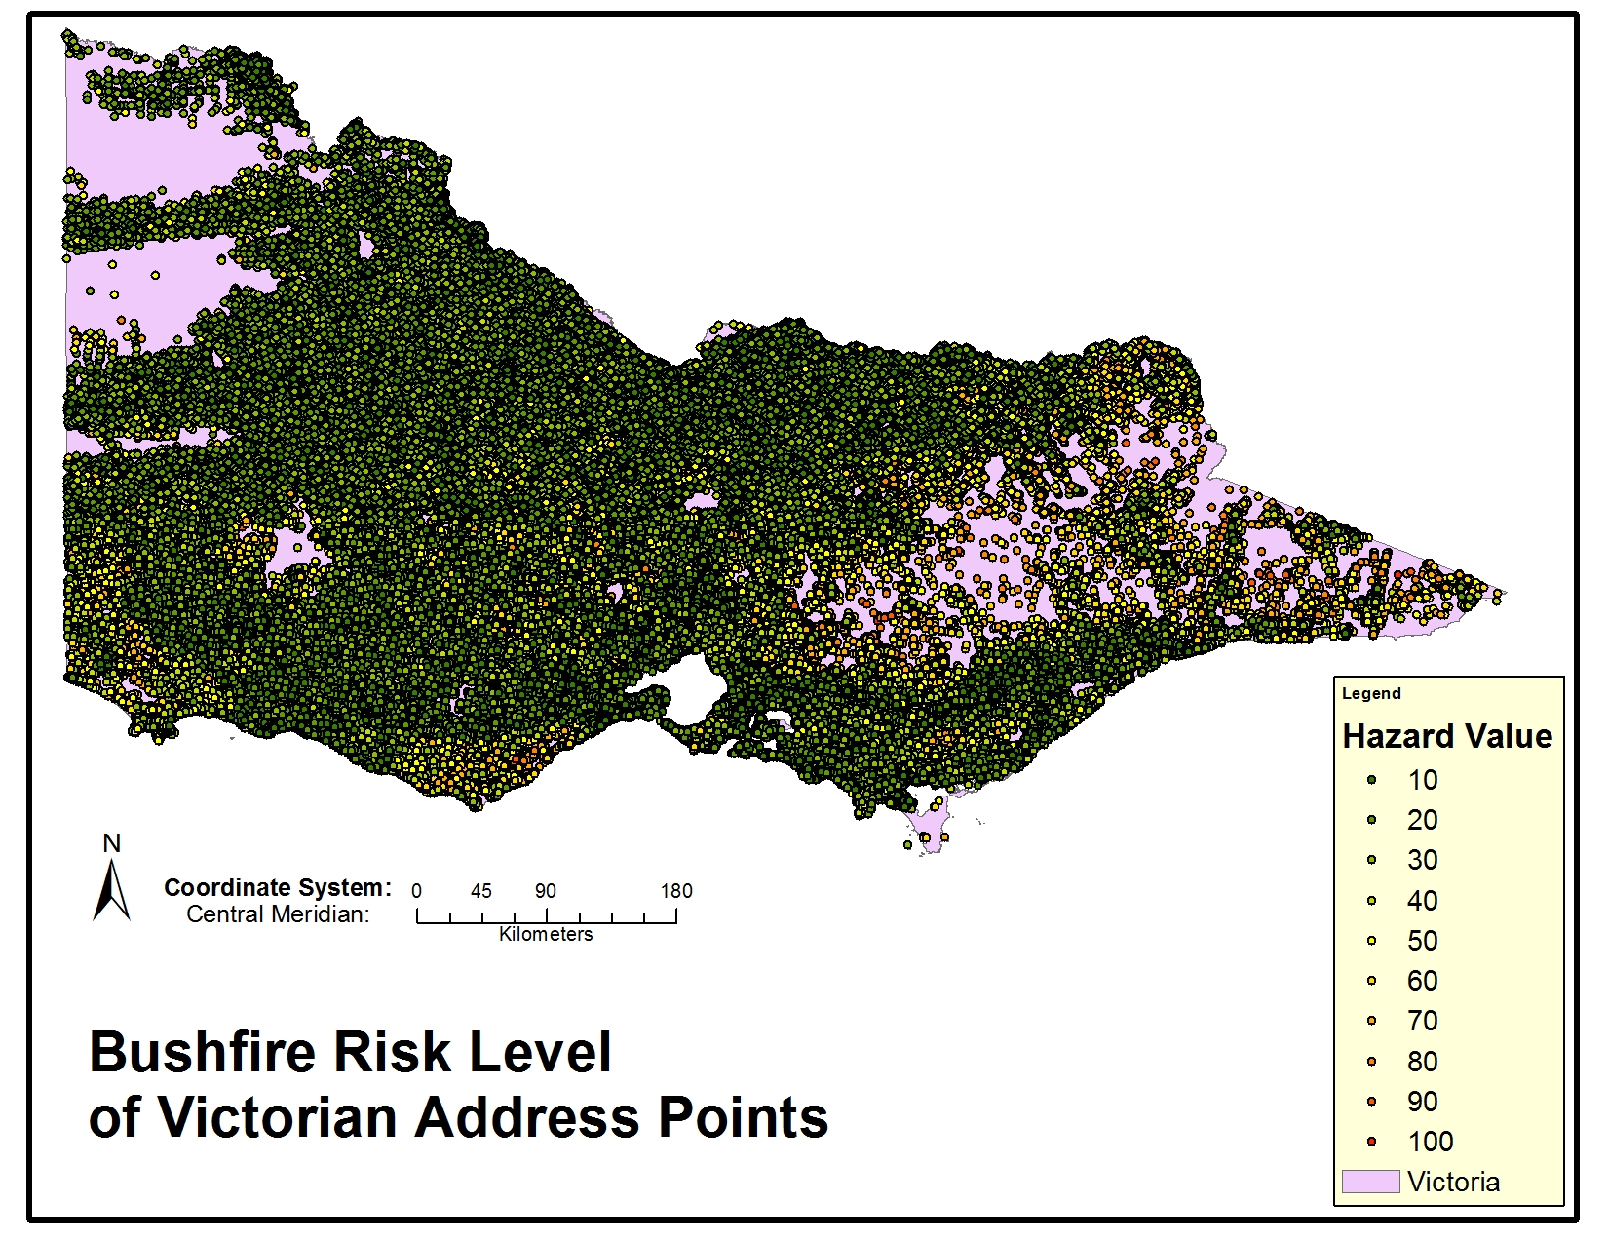
Example maps: Bushfires

Slide 26
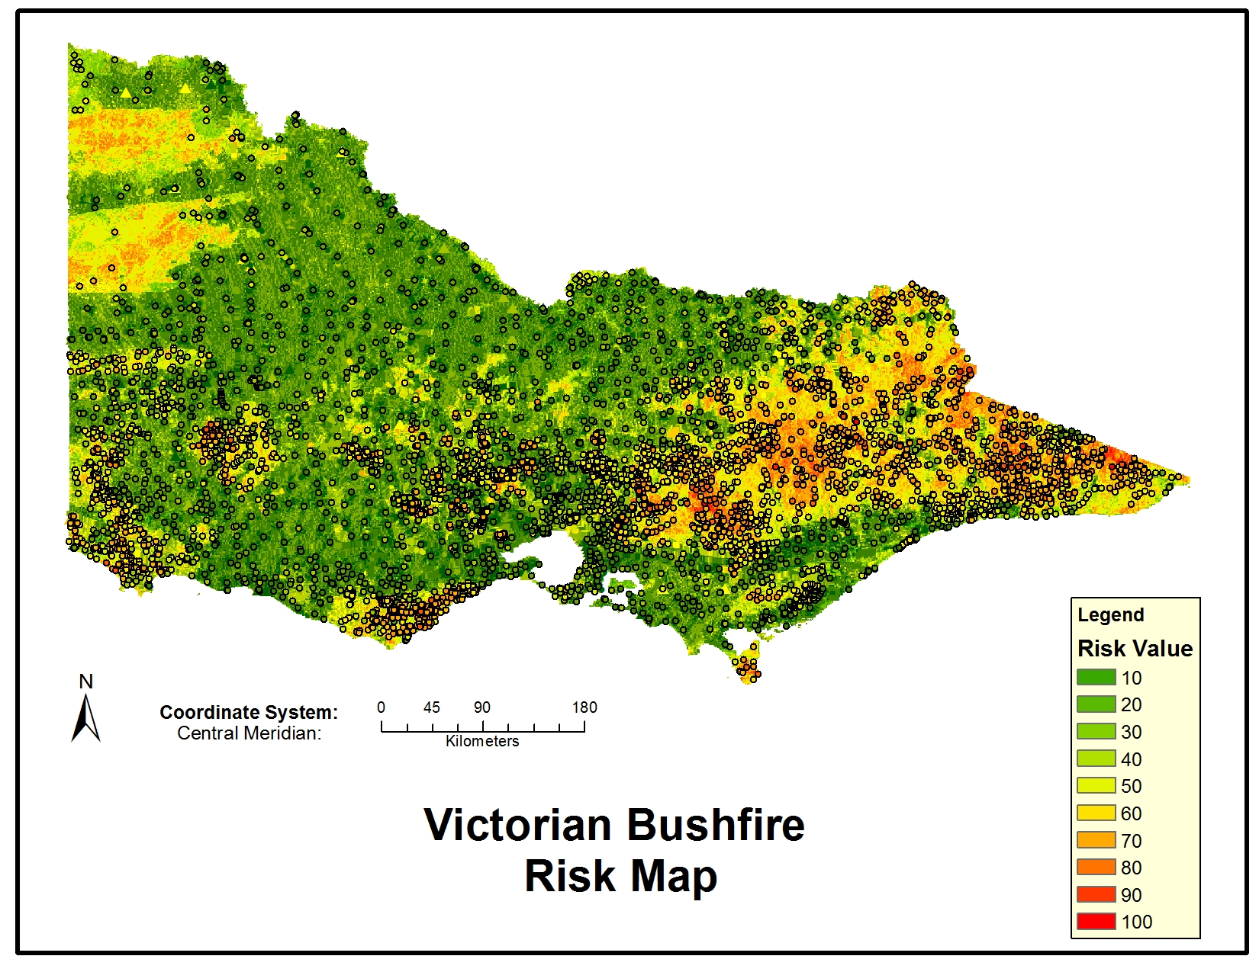
Example maps: Bushfires

Slide 27
What to do now?
Read the assignment description and workflow
Decide whether you will analyse floods or bushfire risk
Start some research on risk analysis
Collect some papers and information on other peoples analysis for Literature Review
Figure out what Hazards, Elements and Vulnerabilities you will analyse. E.g.
Slope
Rainfall
Land use
Etc.
Get data to analyse
LMS
Data.vic.gov.au
Geoscience Australia
BOM
Bring data into ArcGIS Pro to visualise, see if it will be useful.
Start to make Raster Layers with Risk Score 1-100
Combine individual raster layers to make total hazard score map, then total risk score

